Slide 1

PES UNIVERSITY EC Campus Electronic City, Hosur Road, Bangalore-100 A Project Report on EDA ON LANDSLIDES IN AMERICA (2007-2016) DEPARTMENT OF COMPUTER SCIENCE ENGINEERING For the Academic year 2020 by Sohan Naidu (PES2UG19CS398) Haritha Madana (PES2UG19CS141) Serena A. Gomez (PES2UG19CS372) Netra Shaligram (PES2UG19CS253)

Slide 2
INTRODUCTION
R is an open-source programming language and software environment for statistical computing and graphics.
R is a GNU package and is available freely under the GNU General Public License. This means that R is available with source code, and you are free to use R, but you must adhere to the license.
R is a HLL because it shares many similarities to human languages. The R language is widely used among statisticians and data miners for developing statistical analysis and data analysis.
In our project we’ve used the dataset Landslides after rainfall (2007 – 2016) to perform the following:
Exploratory data analysis using various functions.
Data visualization using basic r plots and ggplot.
Statistical analysis using basic functions.
Hypothesis testing.

Slide 3
The Dataset
Name: Landslides after rainfall (2007- 2016)
Source: Kaggle
The dataset consists of 23 columns (features or variables) and 1694 rows(recordings).
Data types and variables:
Numeric variables: id, population, distance, latitude, longitude, fatalities, injuries.
Categorical variables: continent_code, country_name, state/province, city/town, location_description, hazard_type, landslide_type, landslide_size, trigger, storm_name, source_name, source_link.
Temporal data: date, time.
Spatial data: latitude, longitude, geolocation.
Libraries Used.
ggplot2, dplyr, grid, gridExtra, tidyr, glue, scales

Slide 4
DATA STRUCTURES:
Vector: Creation, accessing different parts of vectors extracted from the dataset
Code: id_vector<-data[["id"]]
cat("The first 10 ids in the data set are:",id_vector[1:10])
Lists: Creation of lists using list() from different columns in the dataset, and accessing different values
Code: short_combined_ist<-list("id"=id_vector[1:6],"population"=population_vector[1:6],"State"=state_vector[1:6])
short_combined_ist["id"]
data frame: Extracted the dataset as a data frame and accessed different parts of it.
Code: data<-read.csv("LANDSLIDES.csv")
#The cell at 2nd row and 5th column is:
data[2,5]
matrix: Created a matrix from certain numerical columns in the dataset using cbind(), rbind(), dim(),matrix(), and accessing values.
Code: idval_matrix<-matrix(data$id[1:10],nrow=5,byrow = TRUE)
id_matrix[c(1,2),c(2,3)]
array: Made arrays using array() and accessed different values.
factors: Made factors using factor() and used is.factor(), nlevels(), levels()

Slide 5
OPERATIONS ON DATES
.Used as.Date() to convert the date column in our dataset to dates.
dframe<-read.csv("LANDSLIDES.csv")
dates<-as.Date(dframe$date,"%d-%m-%Y")
.Used:
weekdays(dates)
months(dates)
quarters(dates)
To show the weekdays, months, quarter the date's year lies in.

Slide 6
Conditional Statements in R:
.Demonstrated conditional statements on vectors, data frames, arrays, matrices
On vector: population_level<-ifelse(population_vector<10000,"low","high")
distance_level<-list(ifelse(distance_vector<10,"less","large"))
On data frame: data$populationlevel<-ifelse(population_vector<10000,"low","high")
data$distancelevel<-ifelse(distance_vector<10,"low","high")
On matrix: condmatrix<-ifelse(id_matrix%%3==0,0,id_matrix)
On an array:
lat_lon_array_sign<-ifelse(lat_long_array>0,1,0)

Slide 7
LOOPS
On vector: A data frame with the data of USA is created and the fatalities column is put into a vector. The total number of fatalities is calculates using a for loop. OUTPUT: [1] 28
On data frame: Using the above created data frame, the total no. of times landslides have occurred due to rain is calculated. OUTPUT: [1] 1096
On matrix: Using dataUSA, two vectors with the landslide size and landslide type is created and put into a matrix. The number of times there was small and mudslide landslide is calculated. OUTPUT: [1] 274
On an array: The province in USA which has the greatest distance in the year 2007 is calculated. OUTPUT: [1] Wyoming

Slide 8
Strings
Sprintf: Simple function that prints a statement. It is a wrapper for the C function.
grep: The grep R function searches for matches of certain character pattern in a vector of character strings and returns the indices that yielded a match.
Union: Calculates the union of subsets of a probability space.
Setdiff: Calculates the (nonsymmetric) set difference of subsets of a probability space.
is.element: is.element() function in R is used to check if elements of first object are present in second object or not. It returns TRUE for each equal value.
Sort: Sort (or order) a vector or factor (partially) into ascending or descending order.

Slide 9
Function to show recursion
In the data frame which contains only the data of USA, we calculate the total number of fatalities by using recursion.
s=0
rec_sum <- function(sum,n) {
if(n<=0) {
print("FinalSum")
print(sum)
return (sum)
}
sum = sum + vec_fatalities[n]
rec_sum(sum,n-1)
}
finalSum = rec_sum(s, length(vec_fatalities))
OUTPUT: [1] 28

Slide 10
Usage of functions
All: here vec2 contains fatalities all(vec2>1)//checks if all the fatalities are greater than 1
Any: any(vec2>10)//checks if any of the fatalities are greater than 10
Apply: ma = cbind(fm)// fm is a vector which contains fatalities of Mexico ma1 = apply(ma,2,sum)//adds the values present in the column OUTPUT: fm 284
Which : To get the column number of the column specifies. which(names(data)=="fatalities") OUTPUT: [1] 21

Slide 11
Match : vecm_fatalities contains the fatalities of Mexico vec_fatalities contains the fatalities of USA x <- match(vecm_fatalities,vec_fatalities)
Order: order(m)// m contains the fatalities of Mexica
Rank: rank(m)//Ranks the province in Mexico based on fatalities(only 2007)
Sub: na=data.frame(head(dataMEX$state.province,6)) sub("P","p",na)
Gsub: gsub("P","p",na) OUTPUT: > sub("P","p",na) [1] "c(\"Veracruz-Llave\", \"puebla\", \"Sinaloa\", \"Puebla\", \"Tabasco\", \"Chiapas\")" > gsub("P","p",na) [1] "c(\"Veracruz-Llave\", \"puebla\", \"Sinaloa\", \"puebla\", \"Tabasco\", \"Chiapas\")"

Slide 12
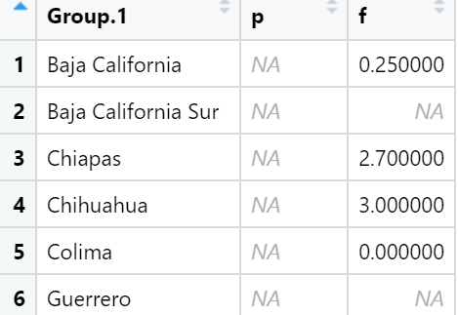
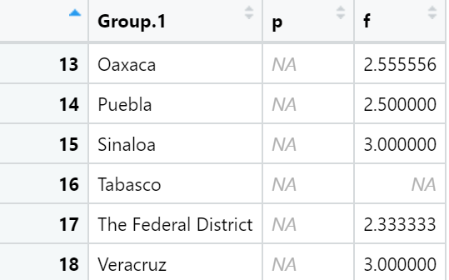
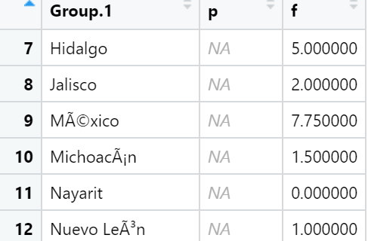
Aggregate:
To calculate the average fatalities of provinces in Mexico
OUTPUT:

Slide 13
Data Preparation for visualization
New year and month columns created.
New column of abbreviated months (MonthAbb) created followed by a column of the ordered months (month_ordered).
Values in landslide type, landslide size, trigger converted to lower case.
Remove all null values from landslide type, landslide size, year and trigger.
Form a new dataset with recordings of the United States.

Slide 14
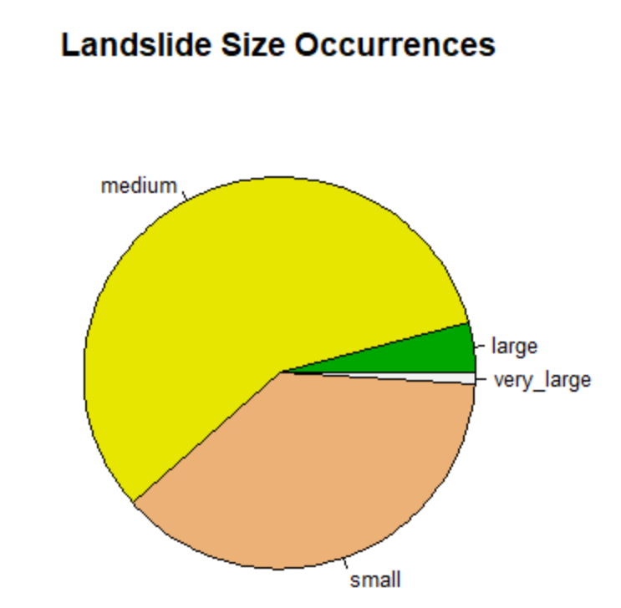
Data Visualization using basic R plots
What size of Landslides are most likely to occur?
Inference:
From the above chart we can infer that medium sized landslides are most likely to occur and very large landslides are least likely to occur.

Slide 15
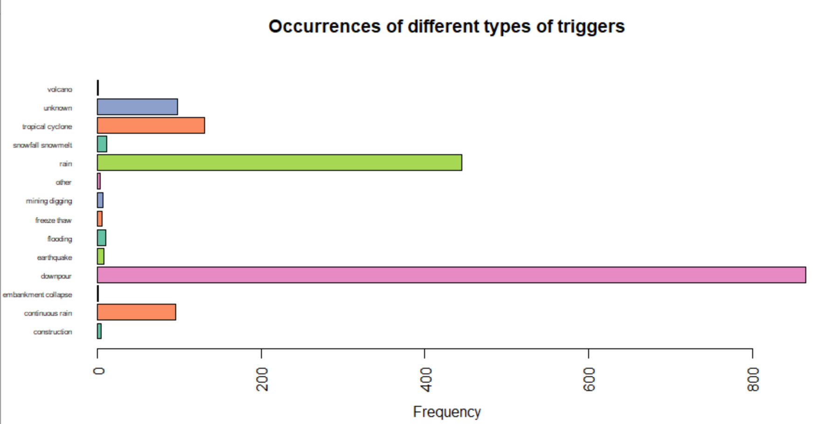
Data Visualization using basic R plots
Occurrence of different types of triggers of landslides:
Inference:
From the above plot we can infer that landslides are most likely to be caused by downpour followed by rain, and it is least likely to be caused by a volcano and embarkment collapse.

Slide 16
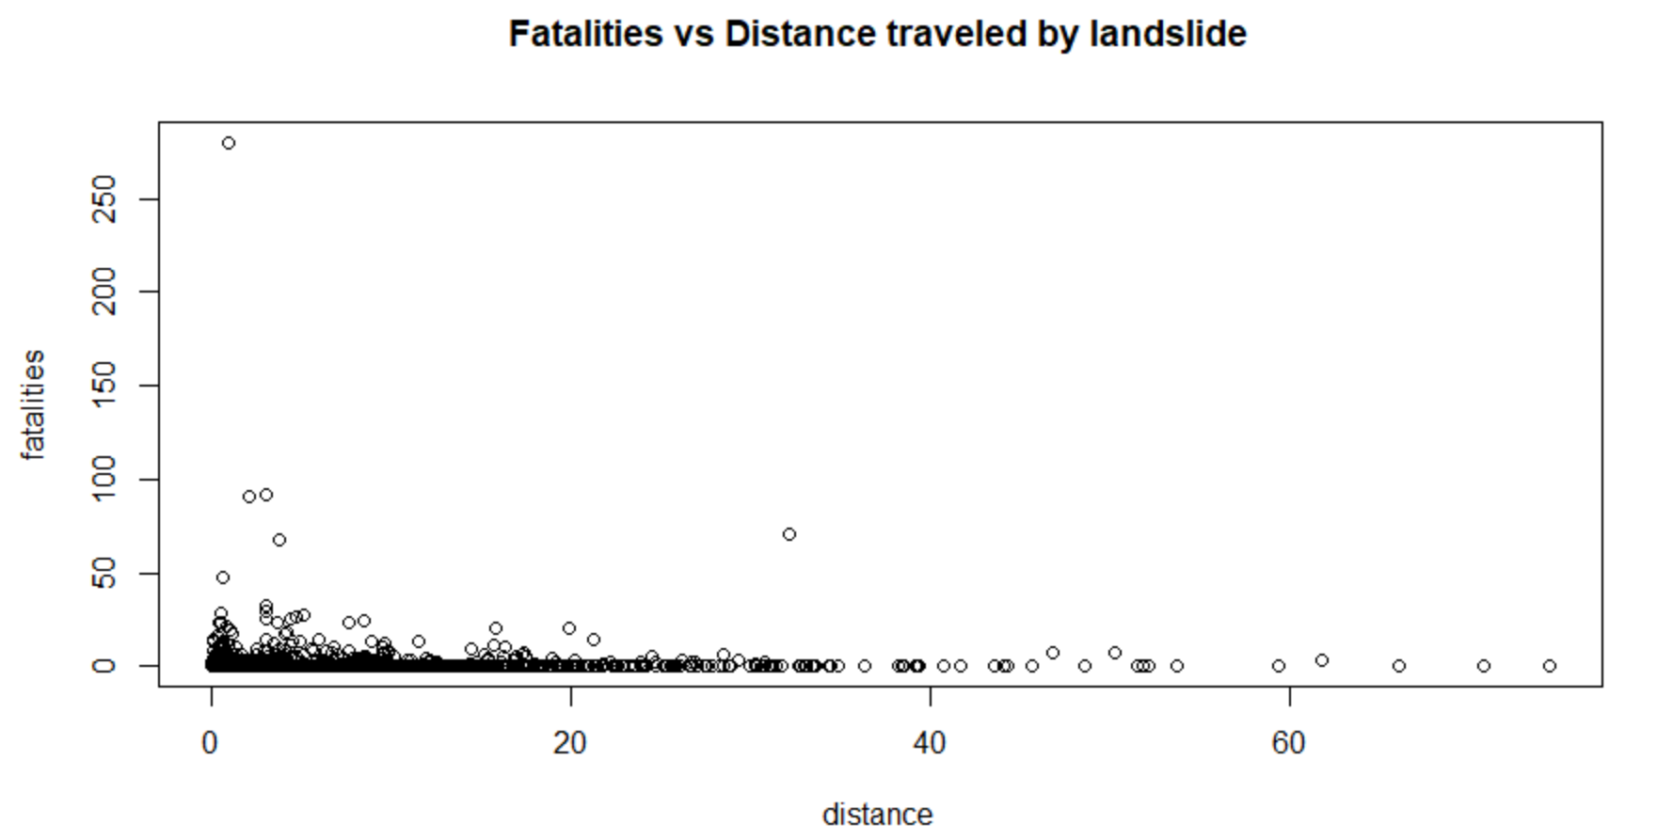
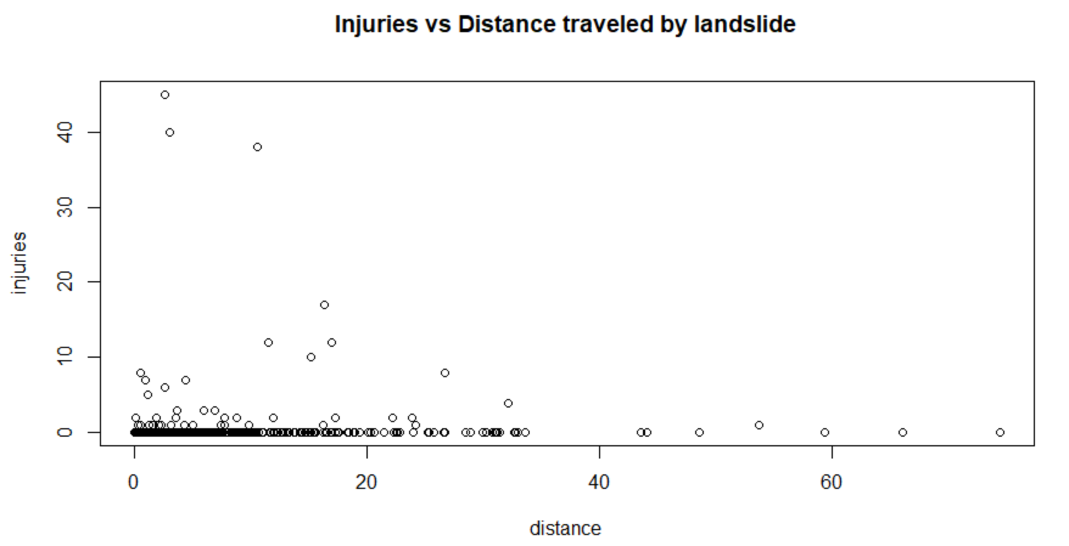
Data Visualization using basic R plots
Number of fatalities and injuries that occurred vs the distance travelled by the landslide:
Inference:
From the above plots we can infer that landslides that happen over a shorter distance are more fatal and injurious than the ones that have been recorded over longer distances.

Slide 17
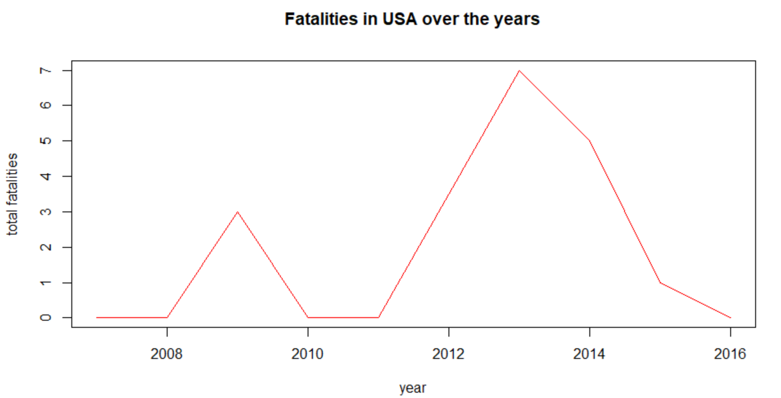
Data Visualization using basic R plots
Fatalities in US over the years
Inference:
From the above plot we can infer that the greatest number of fatalities that occurred in USA due to landslides was around the year 2013.

Slide 18
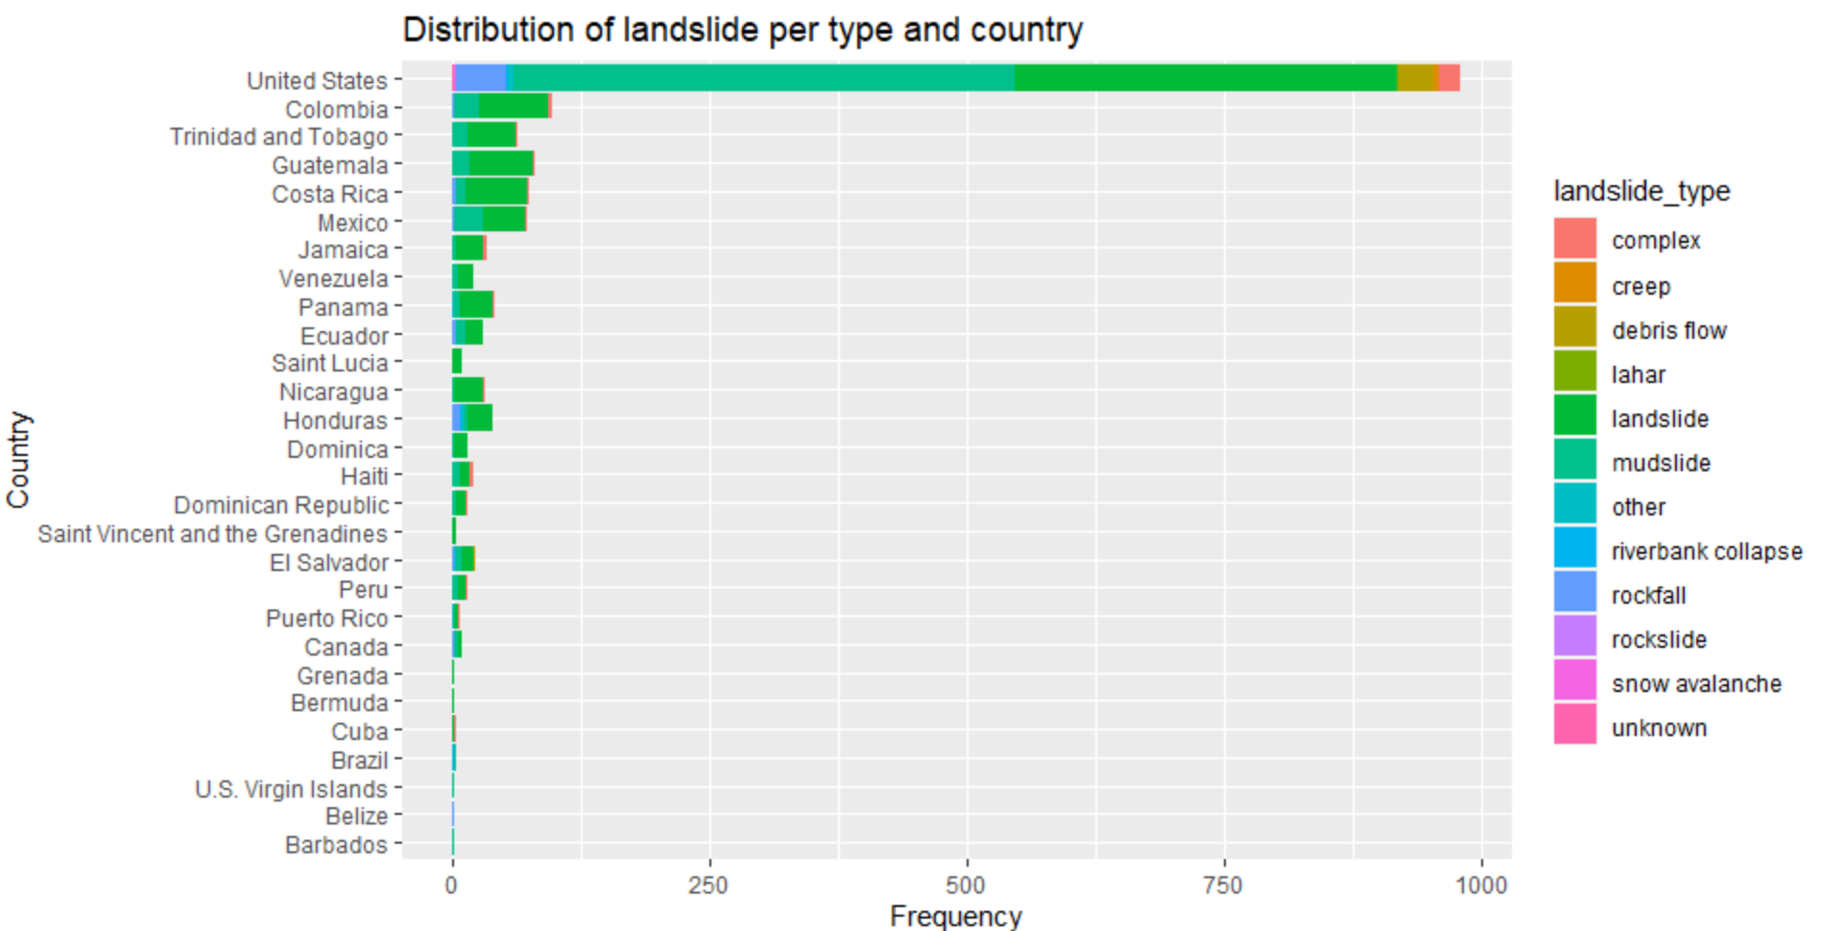
Data visualization using ggplot
Distribution of landslide per type and country:
Steps:
Group the columns by country_name and landslide_type
Summarize the content and calculate the count
Analyze the data using ggplot2 with country name along the x axis and frequency of occurrence of different landslide types along the y axis.
Inference:
From the above plot we can infer:
Landslides most commonly occur in the United States.
Landslides and mudslides are the types of landslides that are most likely to occur.

Slide 19
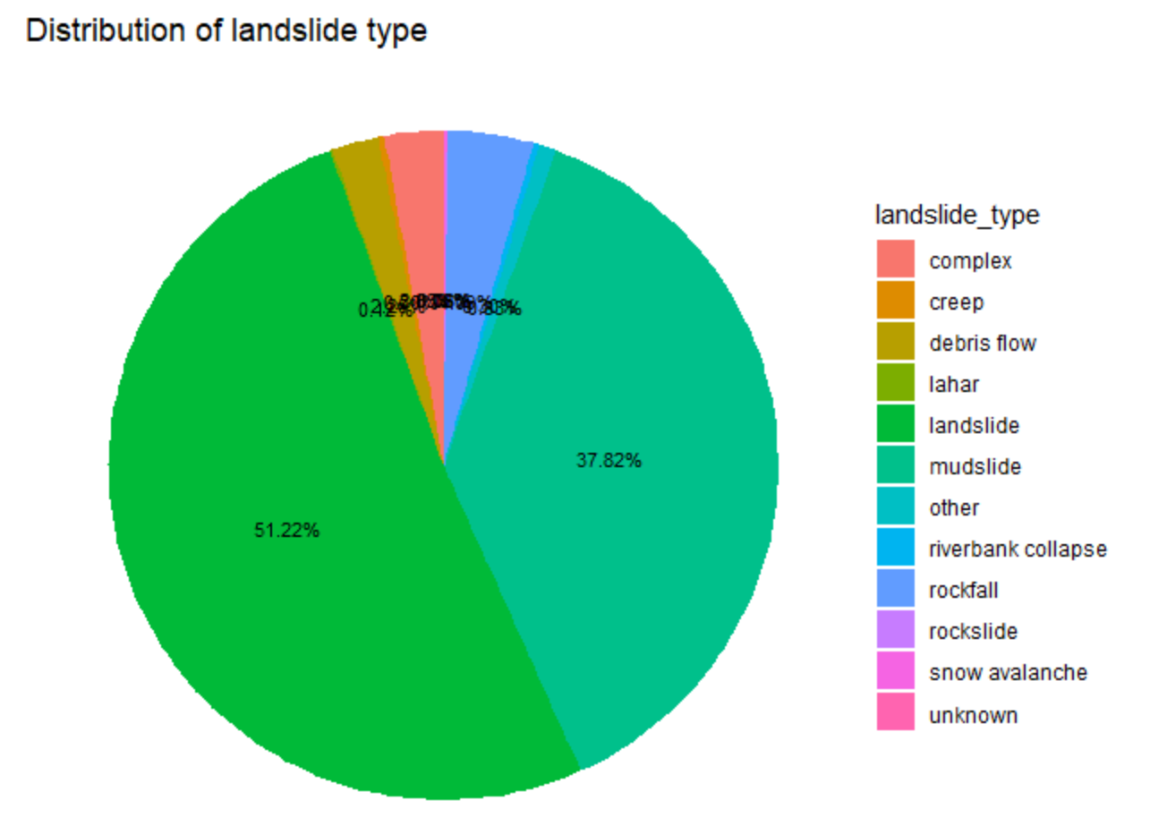
Data visualization using ggplot
Distribution of landslide type:
Steps:
Group the columns by year landslide_type
Summarize the content and calculate the count
Analyze the data using ggplot2
Inference:
From the above plot we can infer that landslides are the most common type of landslide to occur followed by mudslides.

Slide 20
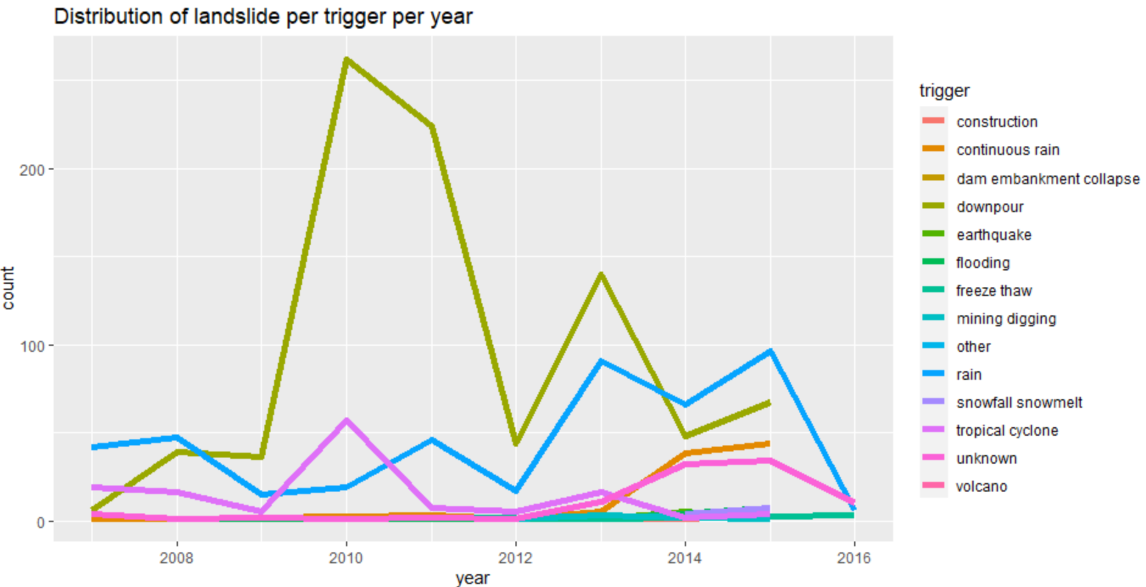
Data visualization using ggplot
Distribution of landslides per trigger per year:
Steps:
Group the columns by year and trigger
Summarize the content and calculate the count
Analyze the data using ggplot2 with year along the x axis and frequency of occurrence of different triggers along the y axis.
Inference:
From the above plot we can infer that landslides are most commonly triggered by downpour followed by rain.

Slide 21
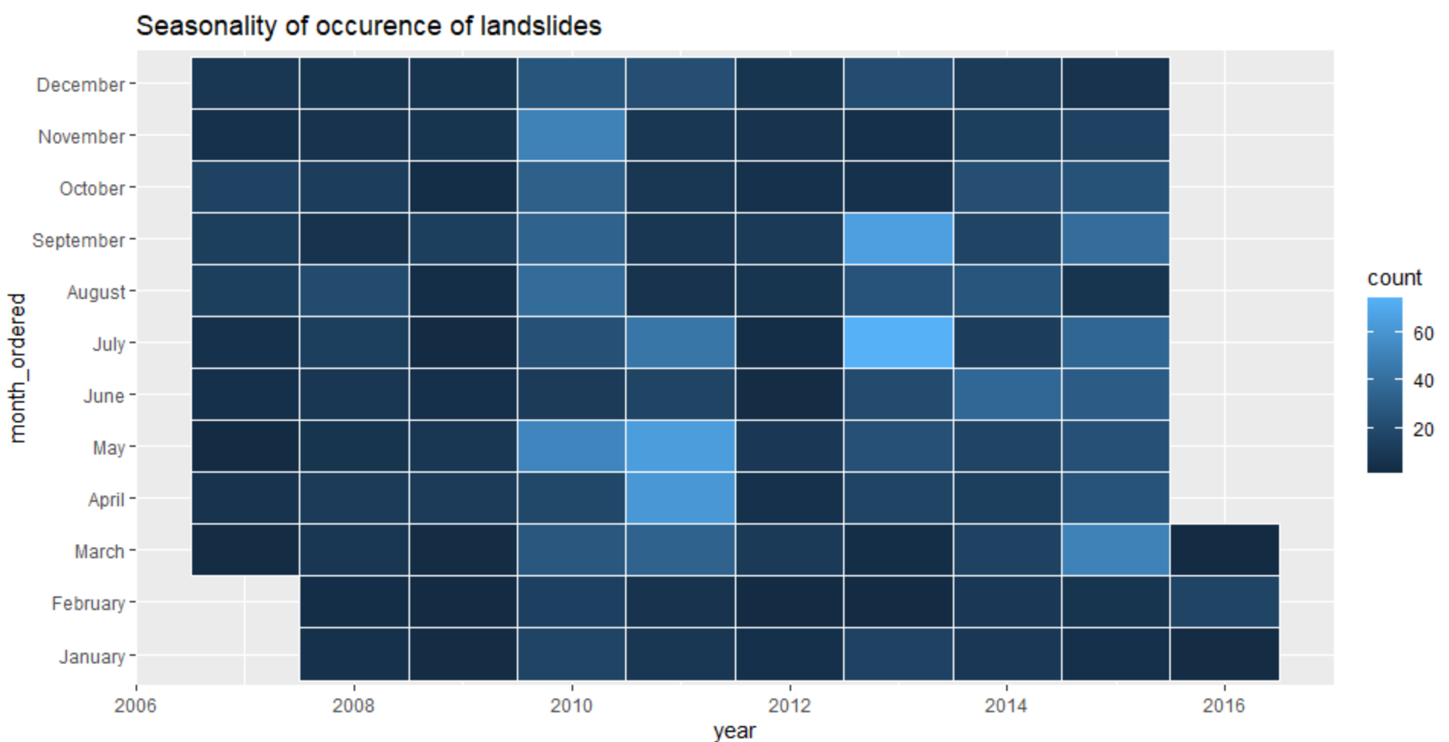
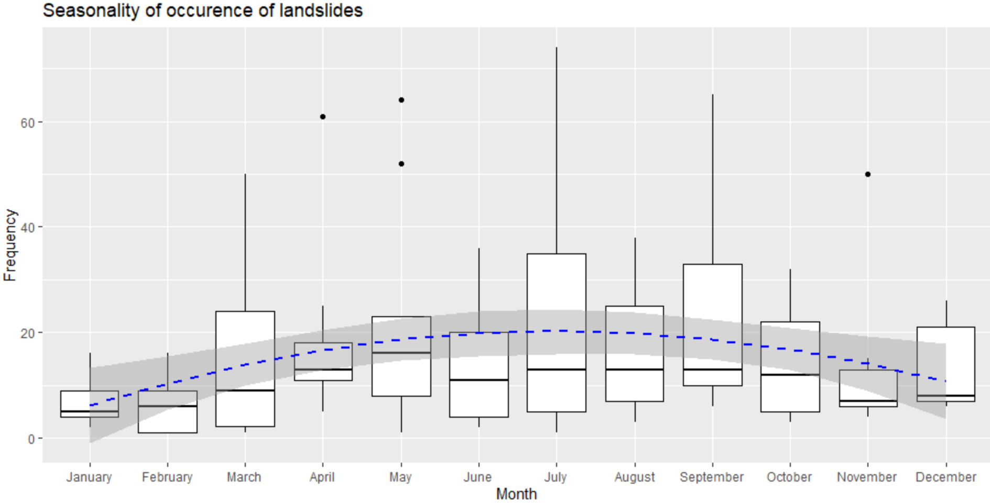
Data visualization using ggplot
To check if there is a seasonality of occurrence of landslides:
Steps:
Group the columns by year and month_ordered
Summarize the content and calculate the count
Analyze the data using ggplot2 with month_ordered along the x axis and frequency of occurrence of different year along the y axis.
Inference:
There is no clear seasonality that can be visualized in the heatmap. However, in the boxplots there is a seasonality where in the beginning and end of the year there are less landslides than during the mid of the year.

Slide 22
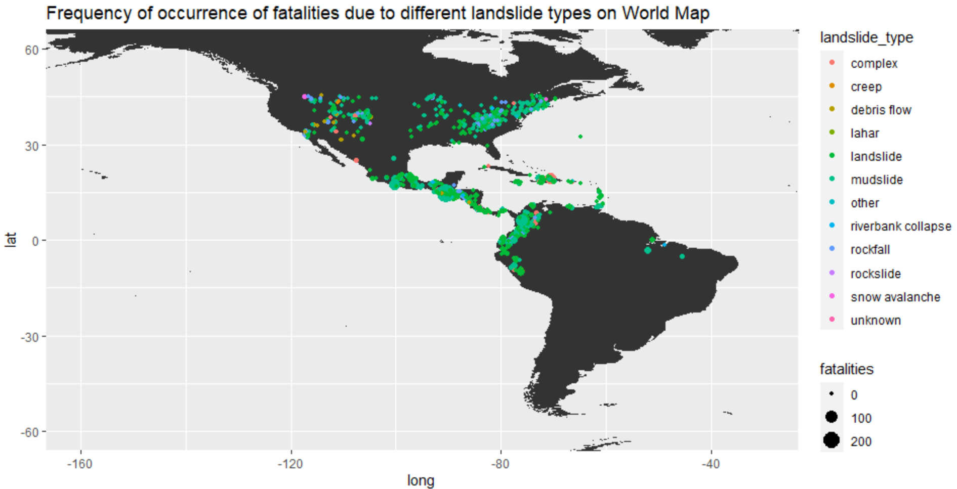
Data visualization using ggplot
To analyze the region of occurrences of various types of landslides and the number of fatalities they caused:
Inference:
From the above plot we can infer:
Most common landslide types are landslides and mudslides.
Most number of fatalities are caused by mudslides.
Landslides are most likely to occur in regions closer to waterbodies.

Slide 23
Statistical Analysis of landslides in 2015
Analysis of fatalities, injuries and distance traveled by landslides
distance fatalities injuries
Min. : 0.02568 Min. : 0.000 Min. : 0.0000
1st Qu.: 1.84109 1st Qu.: 0.000 1st Qu.: 0.0000
Median : 3.89837 Median : 0.000 Median : 0.0000
Mean : 6.64711 Mean : 1.483 Mean : 0.5132
3rd Qu.: 8.38116 3rd Qu.: 0.000 3rd Qu.: 0.0000
Max. :74.46097 Max. :280.000 Max. :45.0000
levels of landslide type, landslide size and triggers:
Landslide type: "creep" "debris flow" "landslide" "mudslide" "other" "riverbank collapse" "rockfall" "rockslide” "unknown"
Landslide size: "large" "medium" "small"
Trigger: "construction" "continuous rain" "downpour" "earthquake" "flooding" "mining digging" "rain" "snowfall snowmelt" "tropical cyclone" "unknown" “volcano”

Slide 24
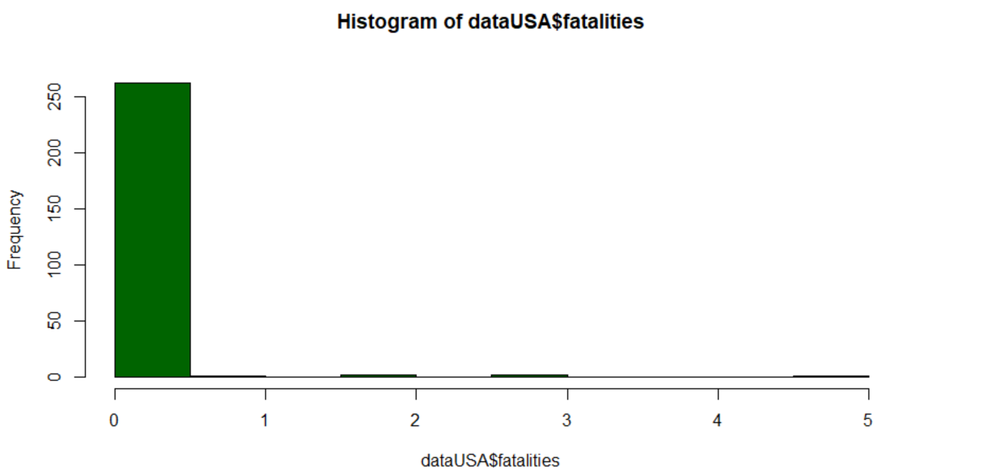
Statistical Analysis of landslides in USA
Analysis of fatalities
mean: 0.05947955
median: 0
standard deviation: 0.4364388

Slide 25
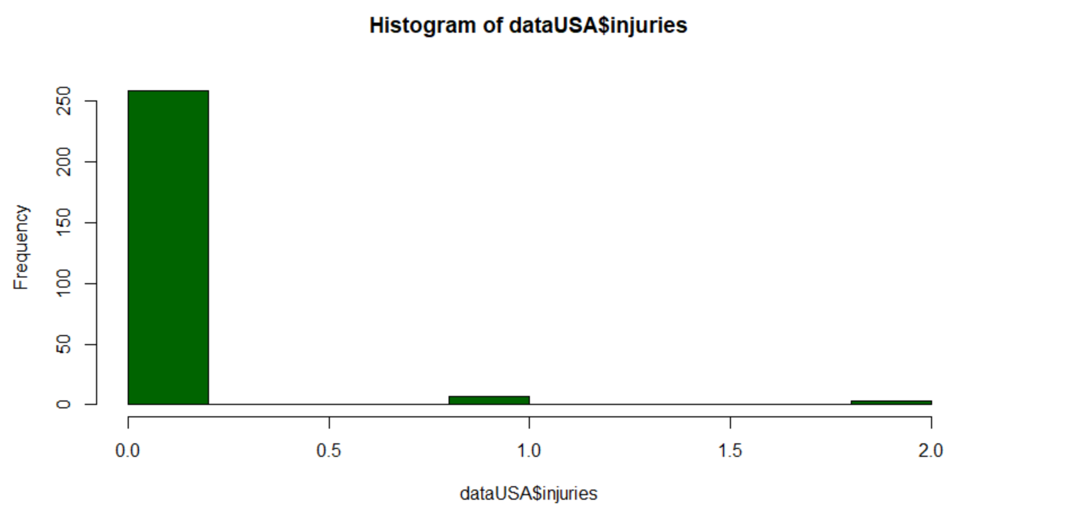
Statistical Analysis of landslides in USA
Analysis of injuries
mean: 0.04832714
median: 0
standard deviation: 0.261823

Slide 26
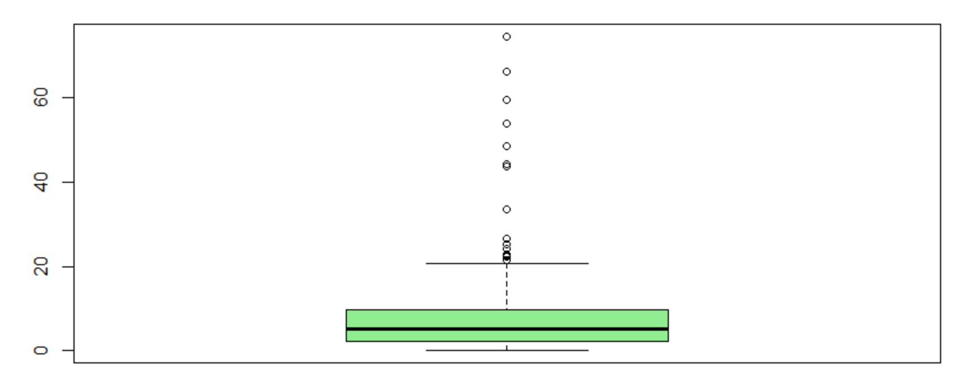
Statistical Analysis of landslides in USA
Analysis of distance traveled by landslide
mean: 7.961526
median: 5.07093
standard deviation: 10.032

Slide 27
Statistical Analysis of landslides in USA
Levels of year, landslide type, landslide size and triggers:
Year: "2007" "2008" "2009" "2010" "2011" "2013" "2014" "2015" "2016"
Landslide type: "complex" "creep" "debris flow" "landslide" "mudslide" "other" "riverbank collapse" "rockfall" "rockslide" "snow avalanche" "unknown"
Landslide size: "large" "medium" "small" "very_large"
Trigger: "construction" "continuous rain" "downpour" "earthquake" "flooding" "freeze thaw" "mining digging" "other" "rain" "snowfall snowmelt" "tropical cyclone" "unknown"

Slide 28
Probability Distribution Function : Normal Distribution
pnorm:
Gives the distribution function. It gives the probability of a normally distributed random number to be less that the value of a given number. It is also called "Cumulative Distribution Function".
Syntax : pnorm(x, mean, sd)
dnorm:
Gives the density. This function gives height of the probability distribution at each point for a given mean and standard deviation.
Syntax : dnorm(x, mean, sd)
qnorm:
Gives quantile function. It takes the probability value and gives a number whose cumulative value matches the probability value.
Syntax : dnorm(p, mean, sd)
rnorm:
Generates random deviates. This function is used to generate random numbers whose distribution is normal. It takes the sample size as input and generates that many random numbers. We draw a histogram to show the distribution of the generated numbers.
Syntax : dnorm(n, mean, sd)

Slide 29
Probability Distribution Function : Normal Distribution
Where :
– x represents the data set of values
– mean(x) represents the mean of data set x. It’s default value is 0.
– sd(x) represents the standard deviation of data set x. It’s default value is 1.
– n is the number of observations.
– p is vector of probabilities
The graph produced after plotting the value of the variable on x-axis and count of the value on y-axis is bell-shaped curve graph. The graph signifies that the peak point is the mean of the data set and half of the values of data set lie on the left side of the mean and other half lies on the right part of the mean telling about the distribution of the values. The graph is symmetric distribution.

Slide 30
Hypothesis Testing:
We use hypothesis testing to check if a hypothesis is true or not.
There are 4 major steps in hypothesis testing:
State the hypothesis- This step is started by stating null and alternative hypothesis which is presumed as true.
Formulate an analysis plan and set the criteria for decision- In this step, significance level of test is set. The significance level is the probability of a false rejection in a hypothesis test.
Analyze sample data- In this, a test statistic is used to formulate the statistical comparison between the sample mean and the mean of the population or standard deviation of the sample and standard deviation of the population.
Interpret decision- The value of the test statistic is used to make the decision based on the significance level. For example, if the significance level is set to 0.1 probability, then the sample mean less than 10% will be rejected. Otherwise, the hypothesis is retained to be true.

Slide 31
CONCLUSION
In this report we:
Installed R and Rstudio.
Used the dataset, Landslides after rainfall (2007 – 2016) to perform the following:
Exploratory data analysis using various functions.
Data visualization using basic r plots and ggplot.
Statistical analysis using basic functions.
Hypothesis testing.
Recorded the observations and inferences.

